Slide 1
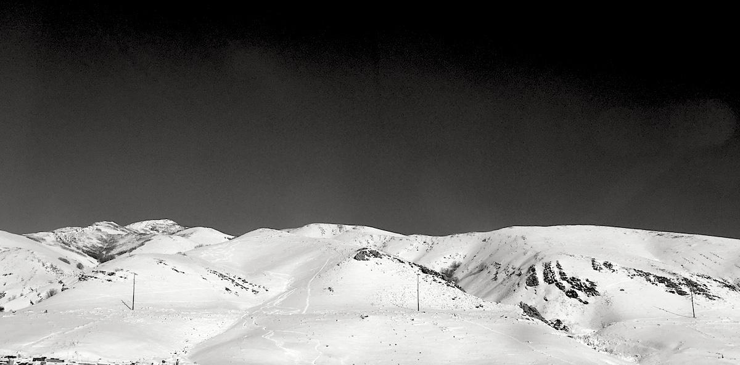
Introduction to UNIX/Linux
Shamelessly Derived (with credit where due) from lectures by
Aaron Quinlan
Departments of Human Genetics and Biomedical Informatics
USTAR Center for Genetic Discovery
University of Utah
quinlanlab.org

Slide 2

What is Unix?
Definition 1: Unix is not an acronym; it is a pun on "Multics". Multics was a large multi-user operating system that was being developed at Bell Labs shortly before Unix was created in the early '70s. Brian Kernighan is credited with the name.
Definition 2: Where computational genomics is done.
Definition 3: Your dear friend and maybe your worst enemy.
Recommended reading: “The Evolution of the Unix Time-sharing system”, Dennis M. Ritchie https://pdfs.semanticscholar.org/f64f/6e66da16e93ebf4221fc8915b2420fd56b66.pdf

Slide 3

Unix history
Ken Thompson (sitting) and Dennis Ritchie working together at a PDP-11
Initial file system, command interpreter (shell), and process management started by Ken Thompson
Device files and further development from Dennis Ritchie, as well as McIlroy and Ossanna (to a lesser degree)
Vast array of simple, dependable tools that each do one simple task.
By combining these tools, one can conduct rather sophisticated analyses
Wildly popular platform for high performance computing. Supports parallelism.
SunOS/Solaris, IBM's AIX, Hewlett-Packard HP-UX, OSX, Linux, Android, etc.
Credit:https://en.wikipedia.org/wiki/History_of_Unix

Slide 4
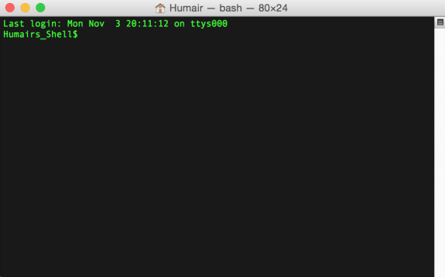
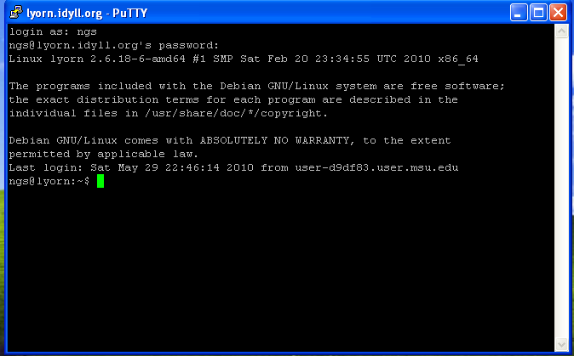
Connecting to a Unix computer via the terminal
In this course we won’t likely be using either. Rstudio provides a terminal we will use instead.
“Terminal” in OSX
“putty” for Windows

Slide 5
The “prompt”
The prompt is just a patient little thing that waits around for you to tell it what to do via “commands”.
Command syntax must be exact. In this way, Unix is dumb. It cannot infer what you meant if you misspell, provide the wrong syntax, etc.

Slide 6
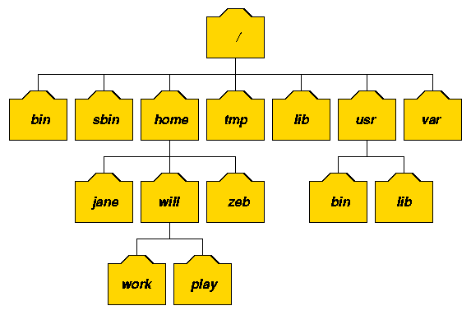
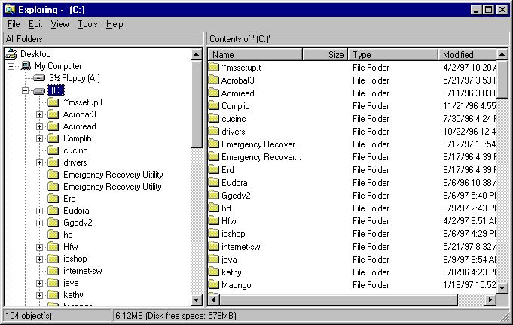
The Unix file system. A tree just like OSX and Windows

Slide 7
Directory hierarchy
Every program installed on a linux system exists somewhere in the filesystem
We can refer to any file or folder with the full “absolute” path (beginning with ”/”)
You can create new files in existing directories and you can create new directories in existing directories
You can NOT create a file in a directory that doesn’t exist (you must explicitly create the directory first)
/usr/bin/
bash
/home/zeb/
/home/will/play/minecraft
/bin/bash
minecraft

Slide 8

The ls command (list files and directories)
(What files and directories can be found in the current directory?)
Example Unix file system (a “tree”)
Imagine we are user “luke”
Luke’s home directory
root
List contents of luke’s home directory
command
result to standard
output (stdout)
$ ls
hi.txt proj1
home
bin
vol
luke
leia
ls
head
cat
hi.txt
proj1
data1.txt
data2.txt

Slide 9
The ls command (list files and directories)
(What files and directories can be found in the current directory?)
Example Unix file system (a “tree”)
Image we are user “luke”
Luke’s home directory
root
list luke’s home directory
$ ls
hi.txt proj1
list luke’s home directory
$ ls ~
hi.txt proj1
home
bin
vol
luke
leia
ls
head
cat
hi.txt
proj1
data1.txt
data2.txt

Slide 10
The ls command (list files and directories)
(What files and directories can be found in the current directory?)
Example Unix file system (a “tree”)
Image we are user “luke”
Luke’s home directory
root
list luke’s home directory
$ ls
hi.txt proj1
list luke’s home directory
(the tilde means “home”)
$ ls ~
hi.txt proj1
home
bin
vol
list luke’s home directory
$ ls ~luke
hi.txt proj1
luke
leia
ls
head
cat
hi.txt
proj1
data1.txt
data2.txt

Slide 11
The ls command (list files and directories)
(What files and directories can be found in the current directory?)
Example Unix file system (a “tree”)
Image we are user “luke”
root
list luke’s home directory
$ ls
hi.txt proj1
list luke’s home directory
$ ls ~
hi.txt proj1
home
bin
vol
list luke’s home directory
$ ls ~luke
hi.txt proj1
luke
leia
ls
head
cat
list the “usr” directory
$ ls /home
luke leia
Q: Why does this directory need
a leading “slash”?
A: It is special because it is one “level” below “root”
hi.txt
proj1
data1.txt
data2.txt

Slide 12
The ls command (list files and directories)
(What files and directories can be found in the current directory?)
Example Unix file system (a “tree”)
Image we are user “luke”
root
list luke’s home directory
$ ls
hi.txt proj1
list luke’s home directory
$ ls ~
hi.txt proj1
home
bin
vol
list luke’s home directory
$ ls ~luke
hi.txt proj1
luke
leia
ls
head
cat
list the parent “home” directory
$ ls /home
luke leia
list the content of luke’s “proj1” directory
$ ls proj1
data1.txt data2.txt
hi.txt
proj1
data1.txt
data2.txt

Slide 13
The ls command (list files and directories)
(What files and directories can be found in the current directory?)
Example Unix file system (a “tree”)
Image we are user “luke”
$ ssh luke@kingspeak.chpc.utah.edu
root
list luke’s home directory
$ ls
hi.txt proj1
list luke’s home directory
$ ls ~
hi.txt proj1
home
bin
vol
list luke’s home directory
$ ls ~luke
hi.txt proj1
luke
leia
ls
head
cat
list the “home” directory
$ ls /home
luke leia
list the content of luke’s “proj1” directory
$ ls proj1
data1.txt data2.txt
hi.txt
proj1
$ ls ~leia
list the content of leia’s home directory
data1.txt
data2.txt

Slide 14
The cd command (change directories)
(cd helps to navigate through the Unix directory tree)
Example Unix file system (a “tree”)
Image we are user “luke”
list luke’s home directory
$ ls
hi.txt proj1
root
move to luke’s “proj1” directory
$ cd proj1
list luke’s “proj1” directory
home
bin
vol
$ ls
data1.txt data2.txt
Move “up” the tree to luke’s home directory
$ cd ..
$ ls
hi.txt proj1
luke
leia
ls
head
cat
Move “up” the tree to the “usr” directory
$ cd ..
$ ls
luke leia
hi.txt
proj1
$ cd luke/proj1
Move directly to luke’s “proj1” directory
data1.txt
data2.txt
$ cd /bin
Move to the system “bin” directory

Slide 15
The pwd command (present working directory)
(Where am I? That is, in which directory am I?)
Example Unix file system (a “tree”)
Image we are user “luke”
root
Where am I?
$ pwd
/home/luke
move to luke’s “proj1” directory
$ cd proj1
home
bin
vol
Where am I?
$ pwd
/home/luke/proj1
luke
leia
ls
head
cat
move back to luke’s home directory
$ cd ..
Where am I?
$ pwd
/home/luke
hi.txt
proj1
data1.txt
data2.txt

Slide 16
The mkdir command (make a new directory)
Example Unix file system (a “tree”)
Image we are user “luke”
root
Where am I?
$ pwd
/usr/luke
List luke’s home directory
$ ls
Hi.txt proj1
home
bin
vol
Move to the “proj1” directory
$ cd proj1
luke
leia
ls
head
cat
Make a new “data” directory in proj1
$ mkdir data
hi.txt
proj1
data1.txt
data2.txt
data

Slide 17
Moving around longer distances
Example Unix file system (a “tree”)
Imagine your working directory is /home/luke/proj1/data/
How do we change to /home/leia ?
root
Where am I?
$ pwd
/home/luke/proj1/data
Change by specifying the new path
Using the absolute path
(works from anywhere)
$ cd /home/leia
home
bin
vol
Move up three (one at a time)
Then change to leia
*works only from a directory at this level
luke
leia
ls
head
cat
$ cd ..
$ cd ..
$ cd ..
$ cd leia
hi.txt
proj1
$ cd ../../../leia
Move up three and to leia using the full relative path
*works only from a directory at this level
data1.txt
data2.txt
data

Slide 18
Absolute vs Relative
Example Unix file system (a “tree”)
Absolute paths always point to the same place regardless of your working directory
Relative paths have different behaviour/meaning depending on the working directory (i.e. depends on context). What will the two sets of commands below do differently?
root
$ ls /home/luke
home
bin
vol
luke
leia
ls
head
cat
data
$ cd /home/leia/data
$ ls ../
hi.txt
proj1
$ cd /home/luke/data
$ ls ../
data1.txt
data2.txt
data

Slide 19
The touch command (create an empty file)
Example Unix file system (a “tree”)
Image we are user “luke”
root
Where am I?
$ pwd
/usr/luke
List luke’s home directory
$ ls
Hi.txt proj1
home
bin
vol
Move to the “proj1/data” directory
$ cd proj1/data
luke
leia
ls
head
cat
Create an empty text file called “frost.txt”
$ touch frost.txt
hi.txt
proj1
data1.txt
data2.txt
data
frost.txt

Slide 20
The head command
(peak at the first n lines in an input file or stream)
The contents of frost.txt
$ head -n 5 frost.txt
Whose woods these are I think I know.
His house is in the village though;
He will not see me stopping here
To watch his woods fill up with snow.
My little horse must think it queer
To stop without a farmhouse near
Between the woods and frozen lake
The darkest evening of the year.
He gives his harness bells a shake
To ask if there is some mistake.
The only other sound’s the sweep
Of easy wind and downy flake.
The woods are lovely, dark and deep,
But I have promises to keep,
And miles to go before I sleep,
And miles to go before I sleep.
Whose woods these are I think I know.
His house is in the village though;
He will not see me stopping here
To watch his woods fill up with snow.
My little horse must think it queer
$ head -n 10 frost.txt
Whose woods these are I think I know.
His house is in the village though;
He will not see me stopping here
To watch his woods fill up with snow.
My little horse must think it queer
To stop without a farmhouse near
Between the woods and frozen lake
The darkest evening of the year.
He gives his harness bells a shake
To ask if there is some mistake.

Slide 21
The head command
(peak at the first n lines in an input file or stream)
-n is an argument or parameter to the head command that modulates its behavior. In this case to report the first 5 lines instead of the first 10, which is the default behavior
The contents of frost.txt
$ head -n 5 frost.txt
Whose woods these are I think I know.
His house is in the village though;
He will not see me stopping here
To watch his woods fill up with snow.
My little horse must think it queer
To stop without a farmhouse near
Between the woods and frozen lake
The darkest evening of the year.
He gives his harness bells a shake
To ask if there is some mistake.
The only other sound’s the sweep
Of easy wind and downy flake.
The woods are lovely, dark and deep,
But I have promises to keep,
And miles to go before I sleep,
And miles to go before I sleep.
Whose woods these are I think I know.
His house is in the village though;
He will not see me stopping here
To watch his woods fill up with snow.
My little horse must think it queer
\n
\n
\n
\n
\n
\n
\n
\n
\n
\n
\n
\n
\n
\n
\n
\n
$ head -n 10 frost.txt
Whose woods these are I think I know.
His house is in the village though;
He will not see me stopping here
To watch his woods fill up with snow.
My little horse must think it queer
To stop without a farmhouse near
Between the woods and frozen lake
The darkest evening of the year.
He gives his harness bells a shake
To ask if there is some mistake.
Important!
Each line ends with a special, hidden character called the newline (\n) character.
This is how “head” knows where the lines start and end.

Slide 22
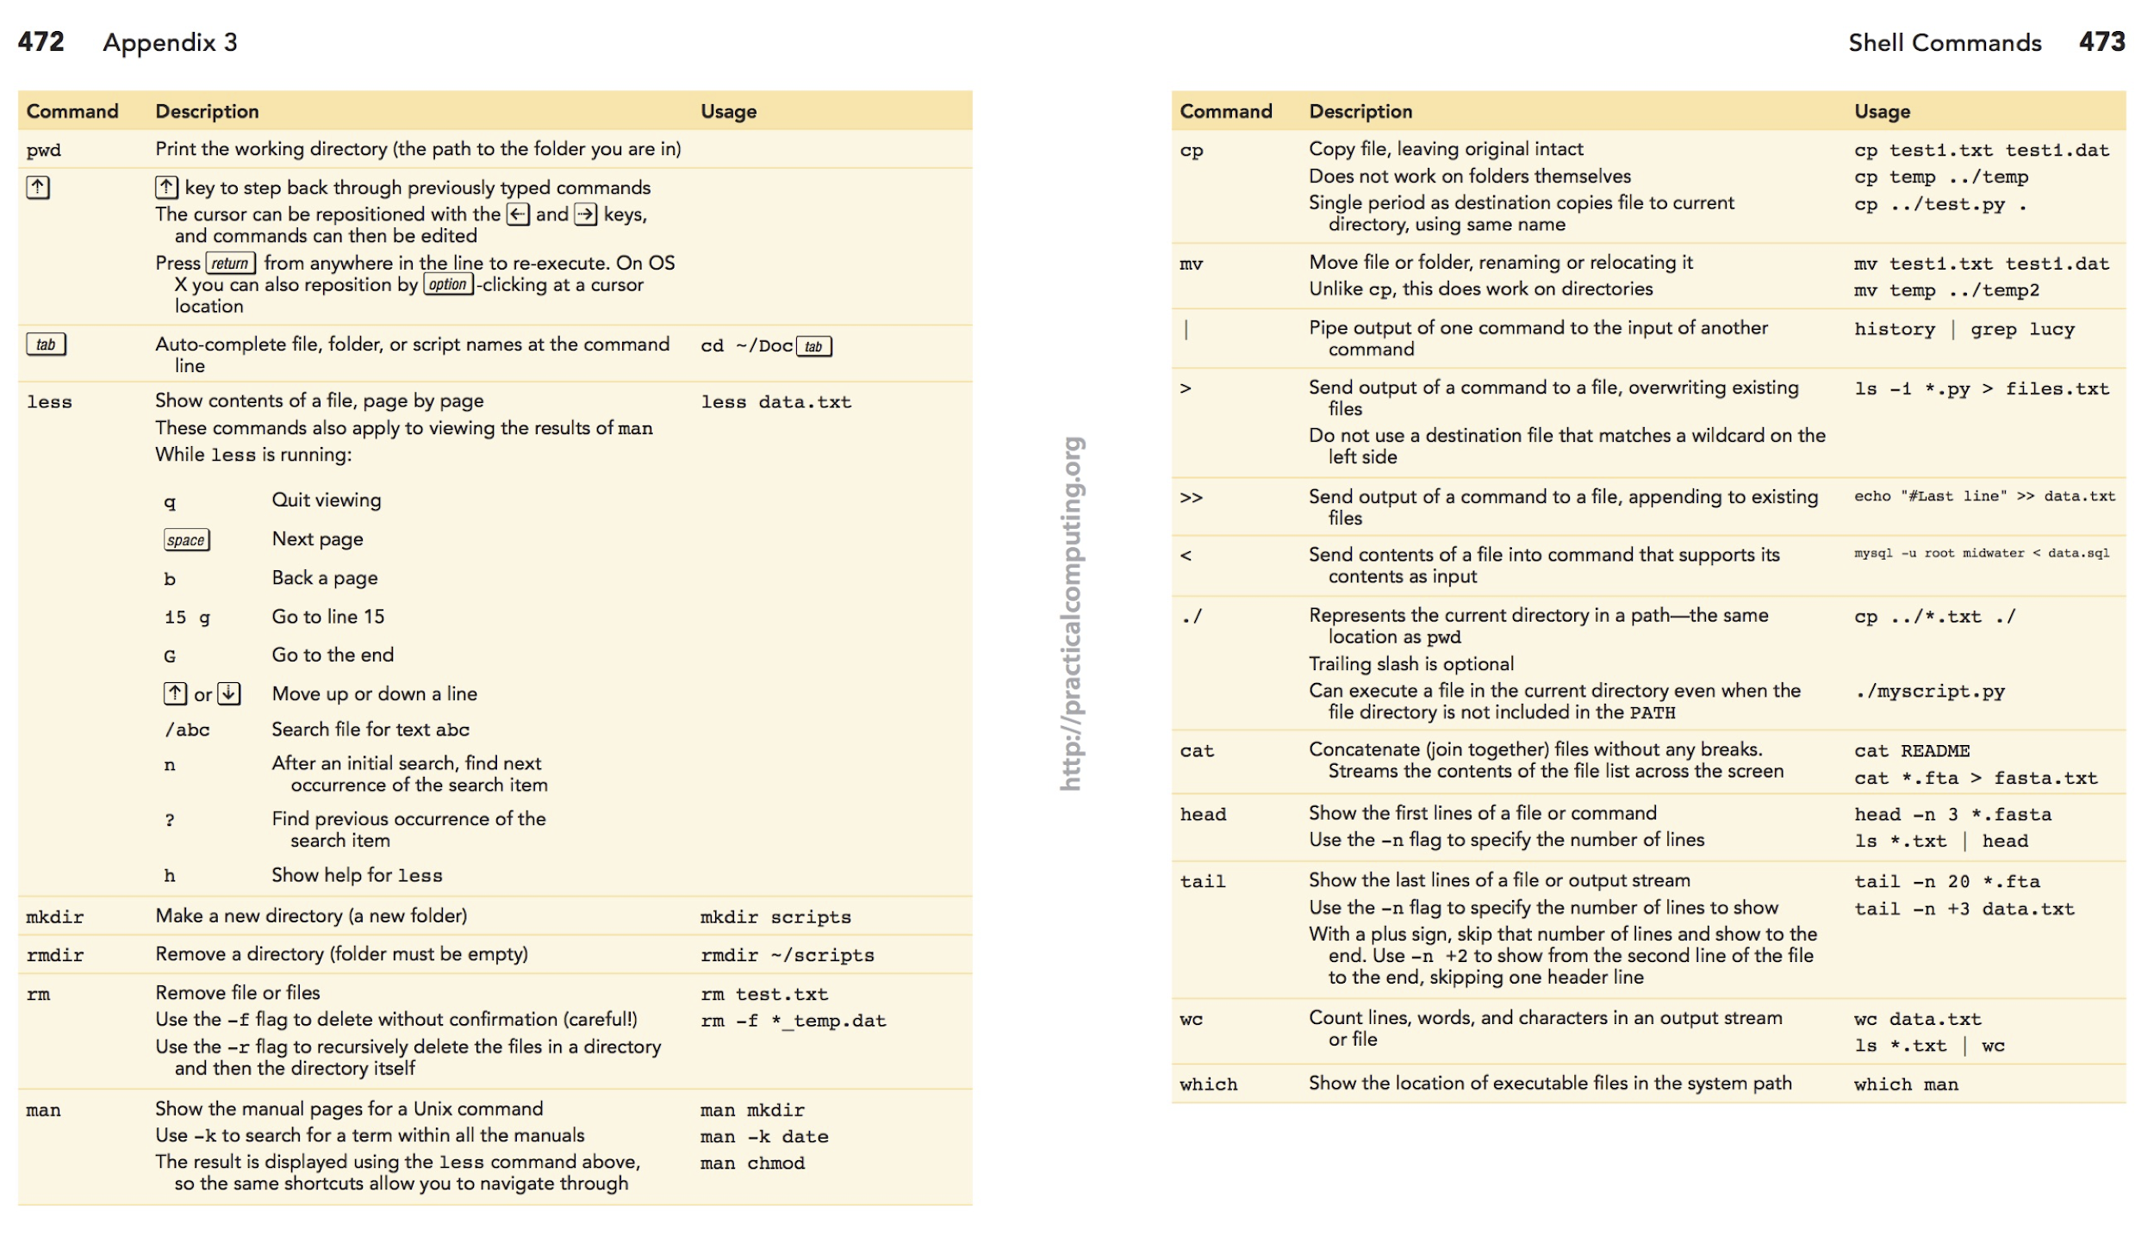
Unix reference “cheat sheet”: (print/mark the link below!)
http://practicalcomputing.org/files/PCfB_Appendices.pdf

